Slide 1
Cracking Windows Passwords

Slide 2
Overview
How Windows Stores Passwords
Rainbow table attack
Cracking Windows Passwords with John the Ripper/Hashcat
Cracking Windows Passwords with Cain

Slide 3
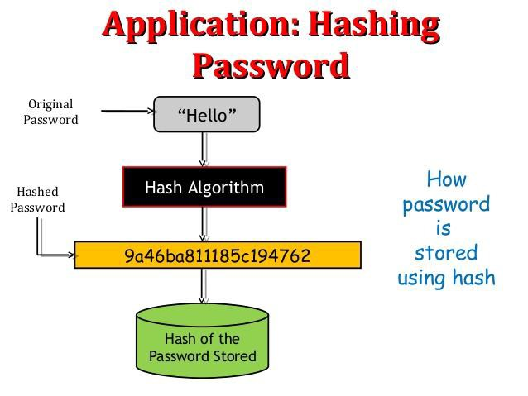
How Windows Stores Passwords

Slide 4
How to hash user passwords
Two methods of hashing of user passwords
LAN Manager (LM)
NT LAN Manager (NTLM)
A hash is the result of a cryptographic function that takes an arbitrarily sized string of data, performs a mathematical encryption function on it, and returns a fixed-size string.
LM hash
NTLM hash

Slide 5
LM vs NTLM
LAN Manager (LM)
Old method
Data Encryption Standard (DES)
Windows 2000, XP, Vista, and 7
NT LAN Manager (NTLM)
the successor of LM
MD4 hashing algorithm
Implemented with Windows NT 4

Slide 6
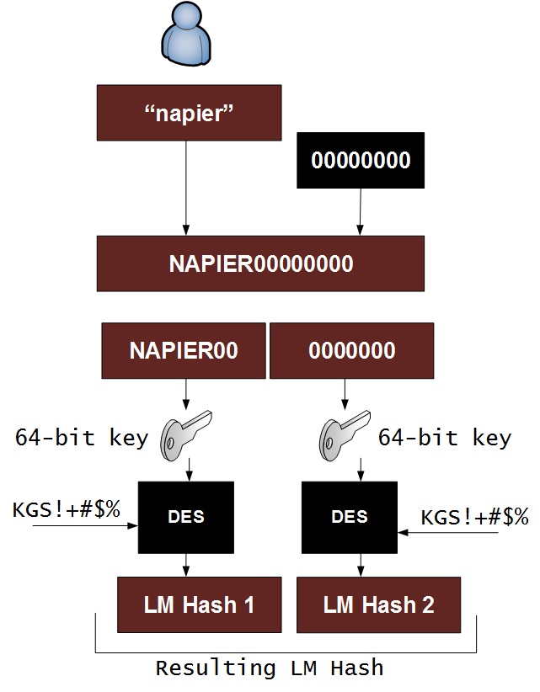
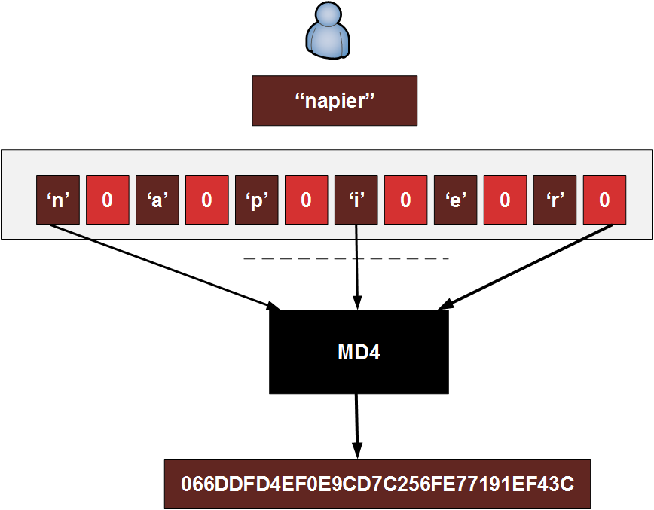
LM vs NTLM

Slide 7
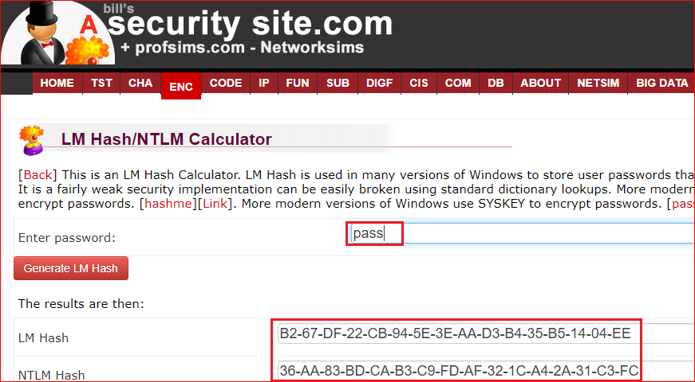
Try by yourself
https://asecuritysite.com/encryption/lmhash?sortby=hashme
B267DF22CB945E3EAAD3B435B51404EE
36AA83BDCAB3C9FDAF321CA42A31C3FC

Slide 8
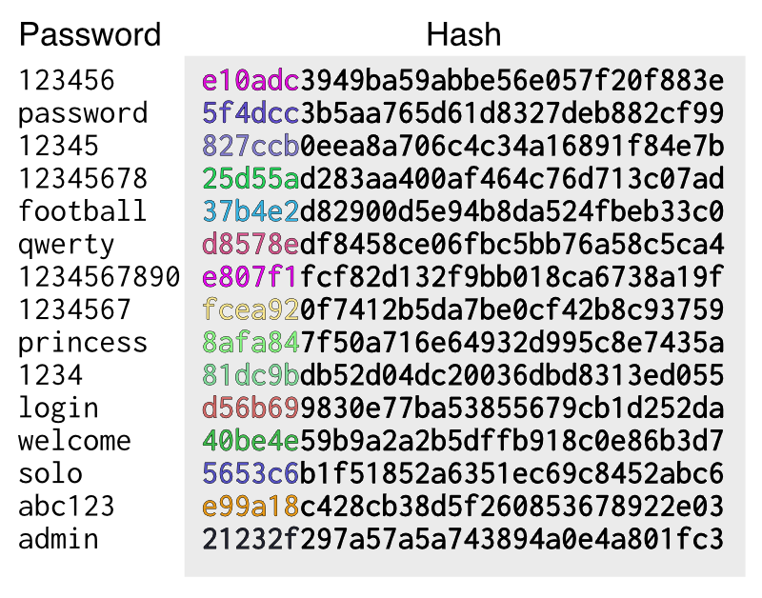
Weakness of NTLM
Brute force attack
not working with long password
Dictionary attack
not working with long password
Problem of these attacks
Need large space if password is long

Slide 9
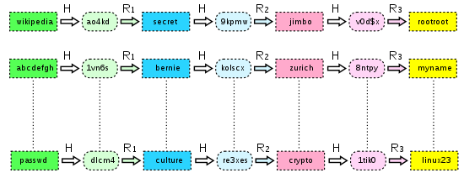
Rainbow tables attack
For any h in Hashes, if R(h)->H() is found in Plaintext, we can find P
A precomputed table for reversing cryptographic hash functions,
Need less space
Plaintexts
Hashes
R
p
H

Slide 10
How extract NTLM hashcode

Slide 11
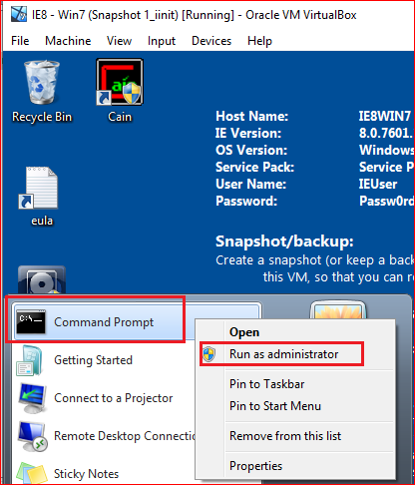
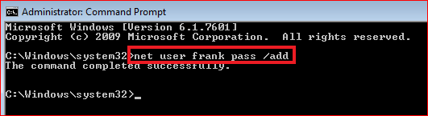
Creating Passwords
net user frank pass /add

Slide 12
Location of NTLM hashes
Stored in the Windows SAM file.
C:\Windows\System32\config
is not accessible while the operating system is booted up.
The registry at HKEY_LOCAL_MACHINE\SAM
not accessible while the operating system is booted.

Slide 13
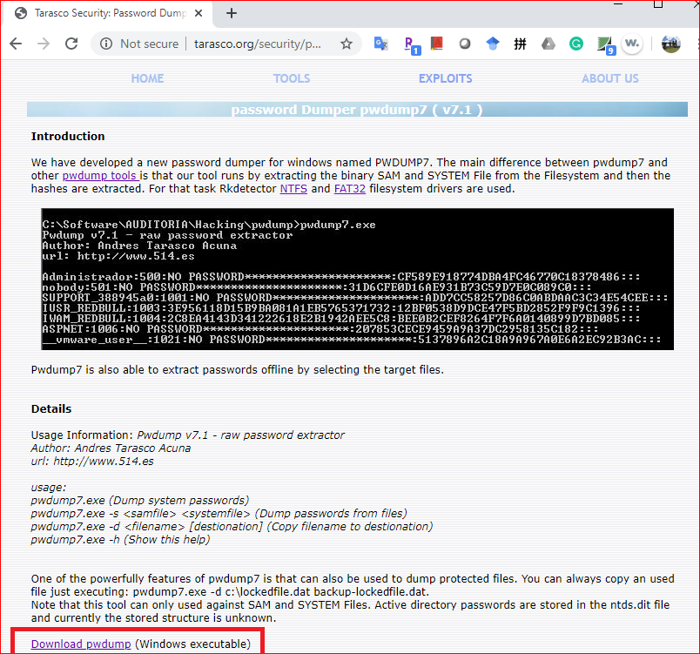
Download Password Dumper
http://www.tarasco.org/security/pwdump_7/

Slide 14
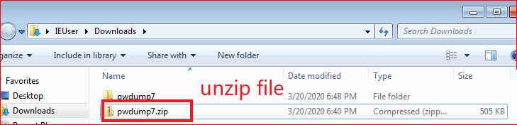
Unzip pwdump7/zip

Slide 15
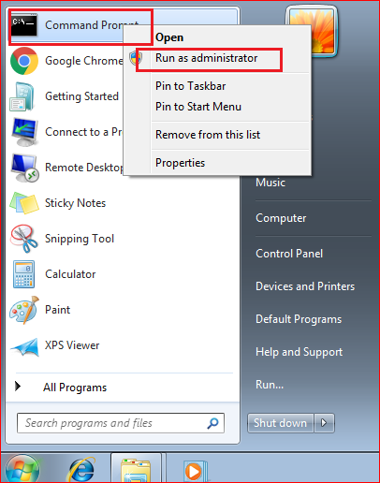
Open Command Prompt
With administrator

Slide 16
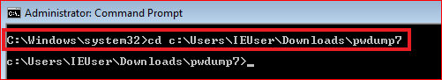
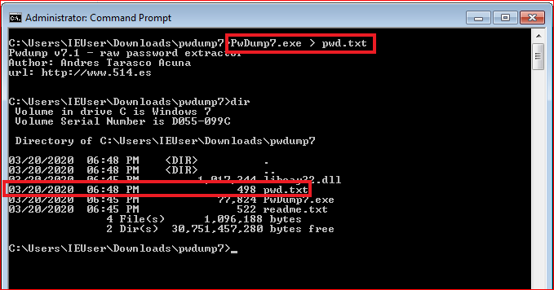
Run dump command

Slide 17
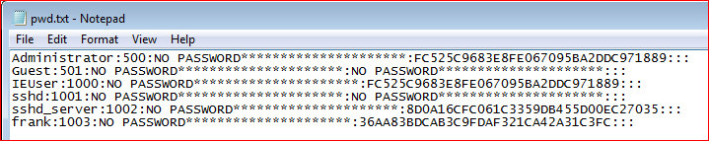
Extracted NTML hashes
Administrator:500:NO PASSWORD*********************:FC525C9683E8FE067095BA2DDC971889:::
Guest:501:NO PASSWORD*********************:NO PASSWORD*********************:::
IEUser:1000:NO PASSWORD*********************:FC525C9683E8FE067095BA2DDC971889:::
sshd:1001:NO PASSWORD*********************:NO PASSWORD*********************:::
sshd_server:1002:NO PASSWORD*********************:8D0A16CFC061C3359DB455D00EC27035:::
frank:1003:NO PASSWORD*********************:36AA83BDCAB3C9FDAF321CA42A31C3FC:::

Slide 18
Cracking Windows Passwords with John Ripper/Hashcat

Slide 19
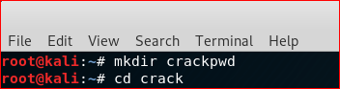
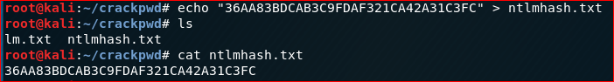
Try use Kali

Slide 20
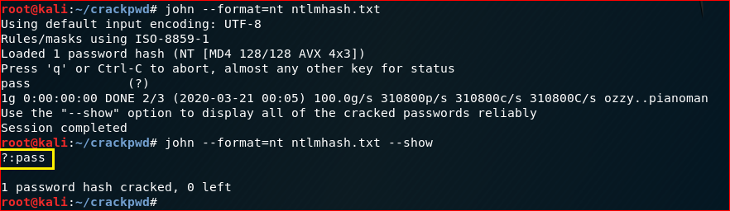
Crack with JohnRipple

Slide 21
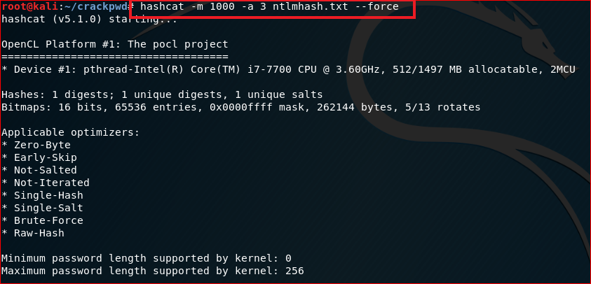
Crack with Hashcat

Slide 22
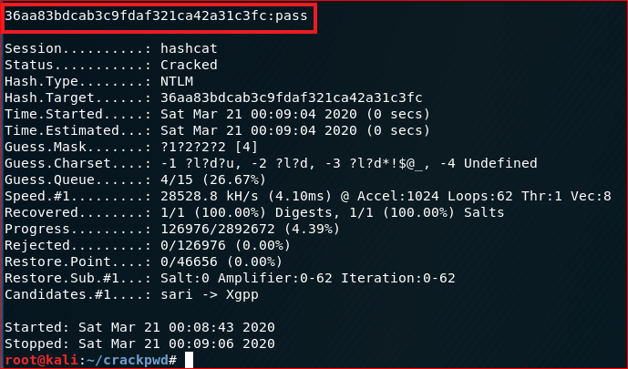

Slide 23
Notes
If you want to crack again

Slide 24
Cracking Windows Passwords with Cain

Slide 25
Cracking Windows Passwords with Cain
Works in Windows 7, 8, and 10
Cain will be detected as malware by your virus scanner.

Slide 26
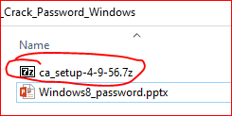
Download Cain
Option 1
https://samsclass.info/123/proj10/ca_setup-4-9-56.7z
Password: sam
Option 2

Slide 27
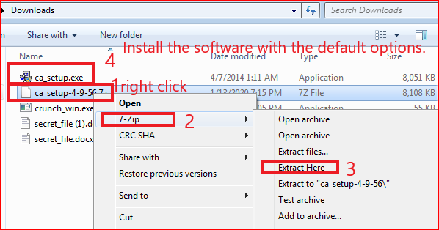
Installing Cain
If you don't have 7-Zip, get it here:
http://www.7-zip.org/

Slide 28
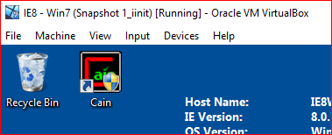
After installation

Slide 29
Creating Passwords
net user frank pass /add

Slide 30
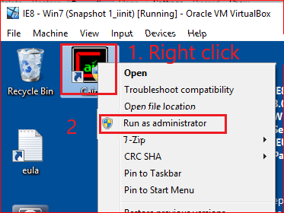
Show Password Hashes

Slide 31
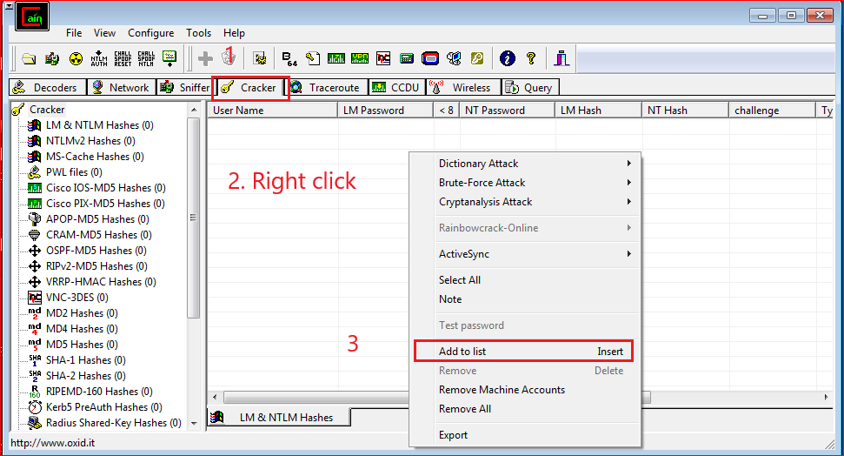

Slide 32
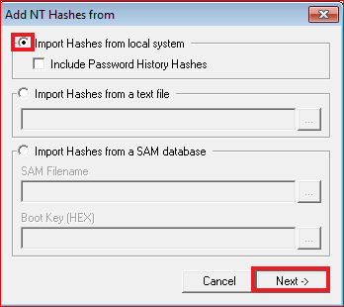
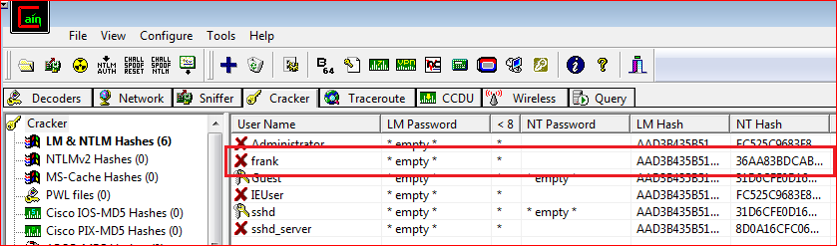

Slide 33
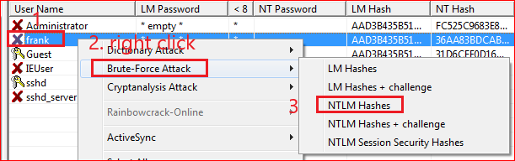
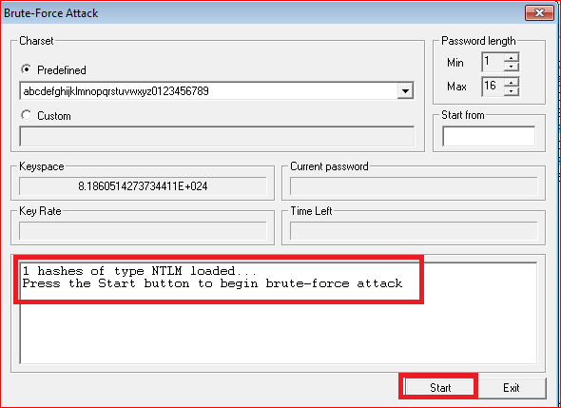
Cracking Passwords

Slide 34
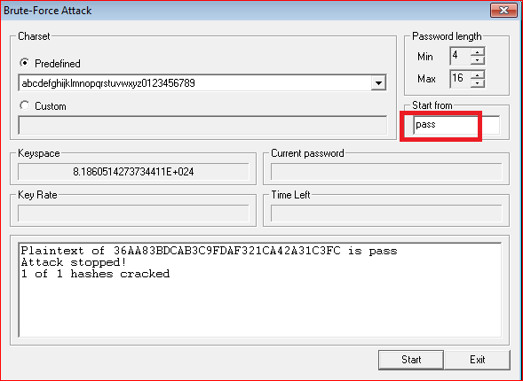
Results

Slide 35
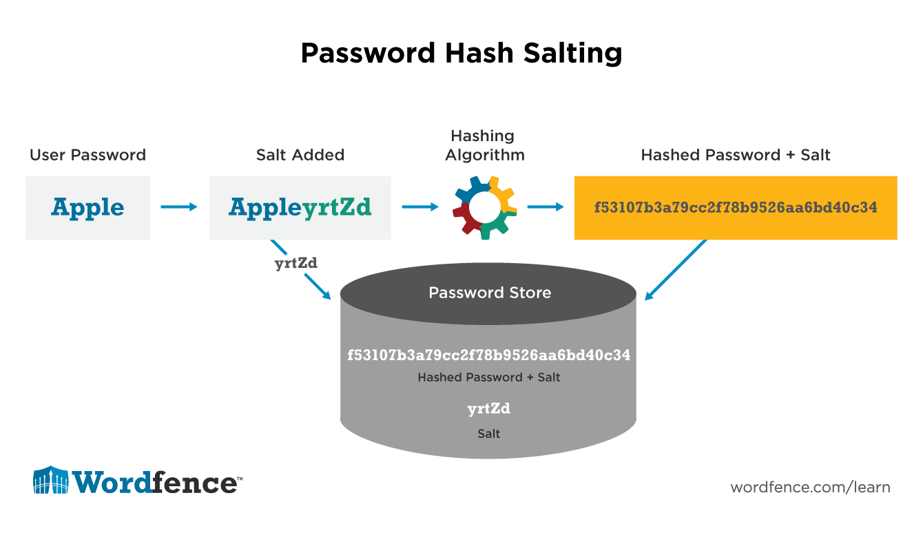
Prevent Attacks

Slide 36
Extra credit: rainbow table attack
Use hashcat to brute-force all 1-7 character passwords (this can be done quickly).
Use hashcat to crack passwords based on rules (variable time).
Use rainbow tables to break complex 8-character passwords (a few hours).
Use rainbow tables to break complex 9-character passwords (a few days).
https://www.rainbowcrackalack.com/

Slide 37
Reference
http://pentestmonkey.net/cheat-sheet/john-the-ripper-hash-formats

